Slide 1
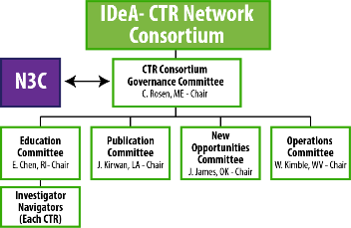
Aim 4: Actively engage IDeA state investigators to enable conduct of high quality COVID-19 data projects (through N3C) relevant to populations in their respective states while facilitating investigator development and participation in N3C

Slide 2

ISCORE NETWORK
Data Analyst
Principal Investigator
Investigator
Analyst

Slide 3


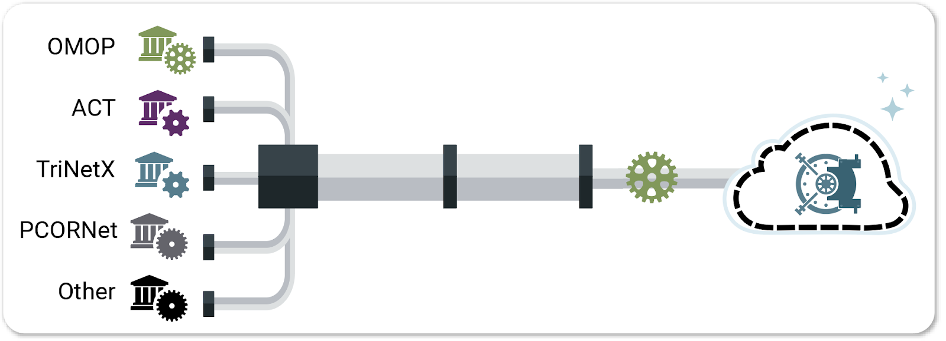






ISCORE- N3C
Goal is to leverage shared knowledge and expertise
Develop team roles and a concrete work plan for each project
ATLAS Concept Browser
N3C Code Workbooks
N3C Contour and Code Workbooks
Characterize Clinical Cohort and Develop Computable Phenotype
Concept Set
Development
and Review
Data Extraction and Quality Review
Data
Analysis
Manuscript
Completion
Team Formation
SMEs
Data Liaisons & N3C Community
Informaticians & Logic Liaisons
Biostatisticians & Analysts
D&I Liaison
Principal Investigators

